Slide 1
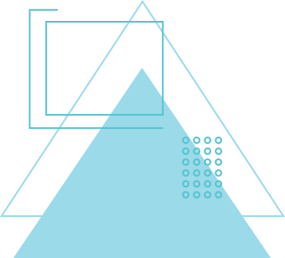
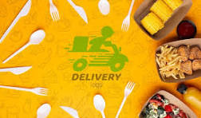
TASTE TRIBE
BY
KEERTHI AACHUTHAN K 221701030
JANAKIRAMAN K
221701023

Slide 2

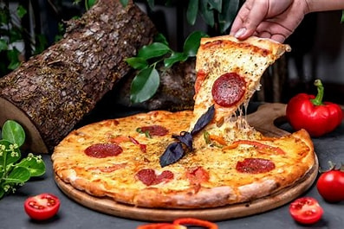
ABSTRACT
This project aims to develop a user-friendly food delivery web application using the MERN stack, connecting customers with restaurants. Key features include user authentication, dynamic menu browsing, secure order placement, and real-time order tracking. An admin panel enables restaurant management for menus and orders. The platform offers a scalable and seamless experience, aspiring to compete with leading services like Swiggy by providing efficient and reliable food delivery solutions.

Slide 3
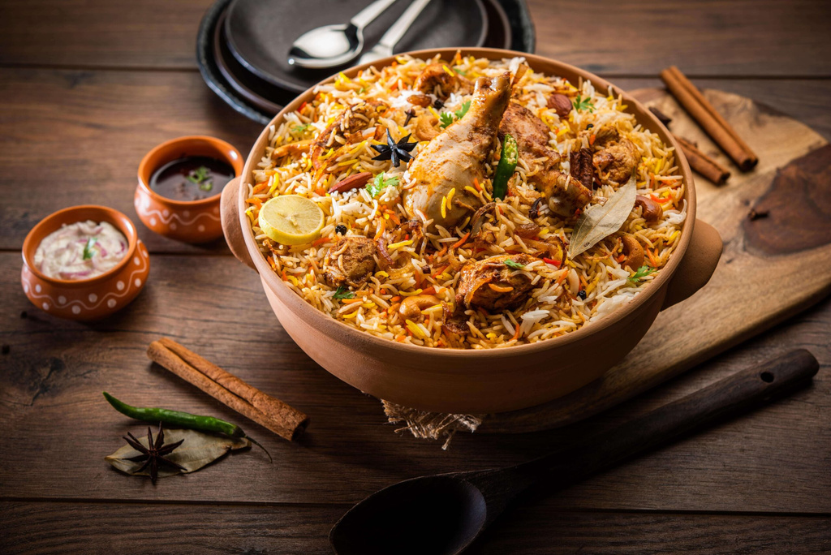
INTRODUCTION
With the rapid growth of the online food delivery industry, there is an increasing demand for efficient, reliable, and user-friendly platforms that connect customers with restaurants. This food delivery application aims to provide a seamless ordering experience, offering features such as menu browsing, secure payments, and real-time order tracking. Using the MERN stack (MongoDB, Express.js, React.js, Node.js), this platform ensures scalability, performance, and security. The web also empowers restaurant partners with an intuitive admin panel for managing menus, orders, and deliveries.

Slide 4

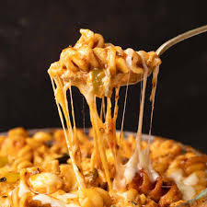
OBJECTIVES
GOAL 01
GOAL 02
Develop a user-friendly platform for seamless food ordering, secure payment, and real-time order tracking.
Provide an efficient admin panel for restaurant management, including menu updates and order processing.

Slide 5
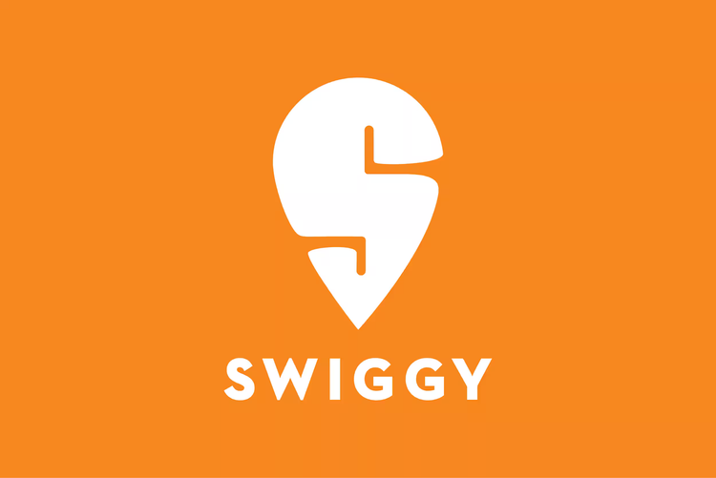

LITERATURE SURVEY
High Commission Rates: Restaurants often complain about high platform charges (Rao et al., 2022).
Delivery Issues: Delays and incorrect orders remain common customer complaints (Tripathi, 2023).
Customer Retention: With intense competition, retaining users requires constant innovation (Saxena & Patel, 2023).
Data Security: Securing sensitive payment and customer data is critical (Aggarwal et al., 2022).

Slide 6


METHODOLOGY
METHOD 01
METHOD 02
Develop the application using the MERN stack, focusing on frontend (React.js) for user experience and backend (Node.js, Express.js) for secure order handling and real-time tracking.
Implement MongoDB for efficient data storage, integrate APIs, and conduct thorough testing to ensure scalability, security, and smooth performance.

Slide 7
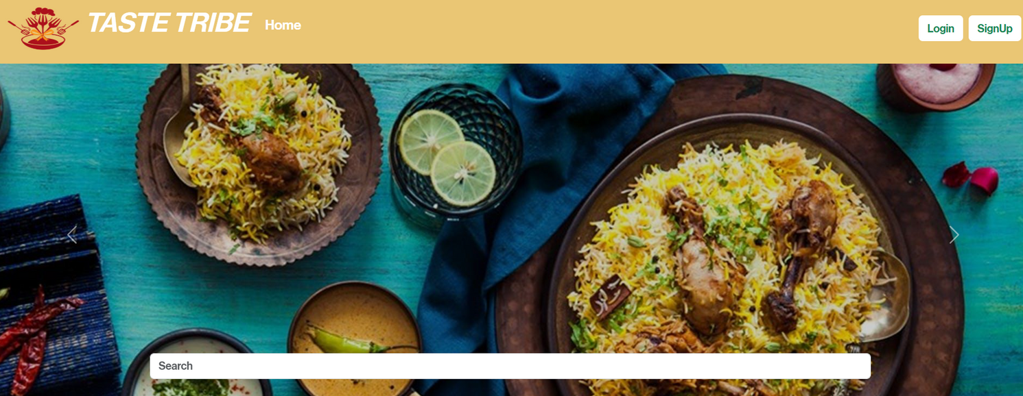
OUTPUT

Slide 8
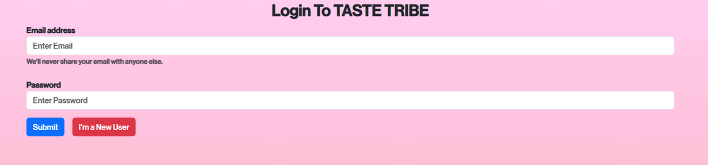
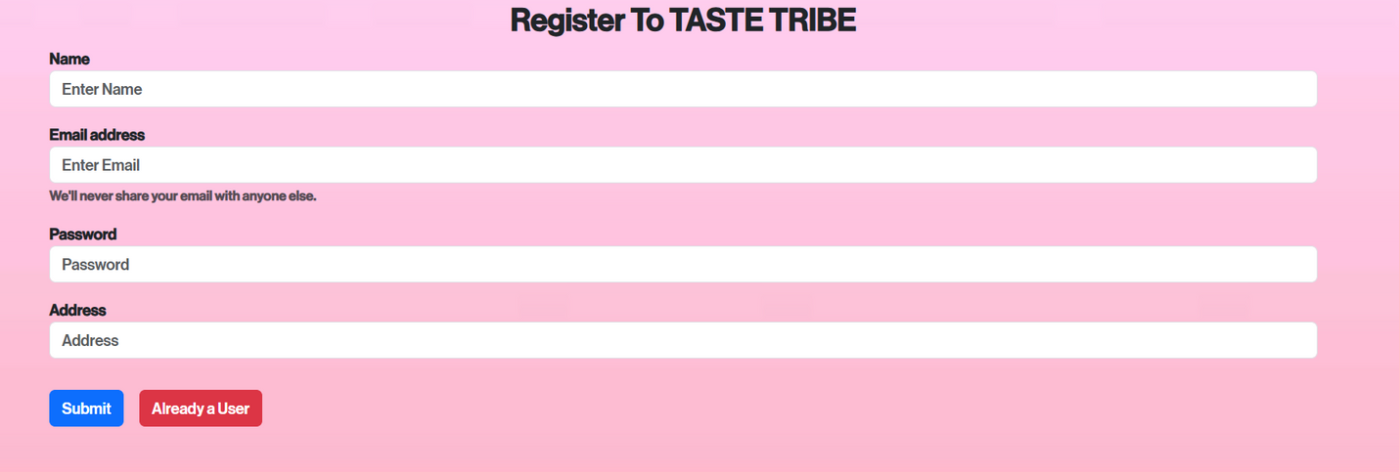
OUTPUT

Slide 9
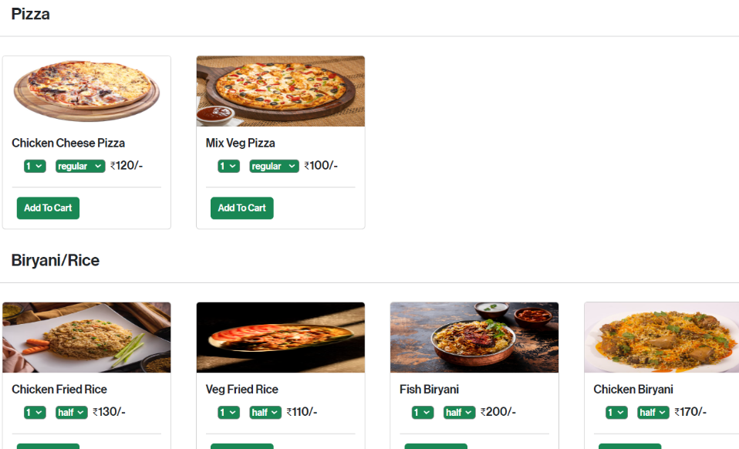
OUTPUT

Slide 10
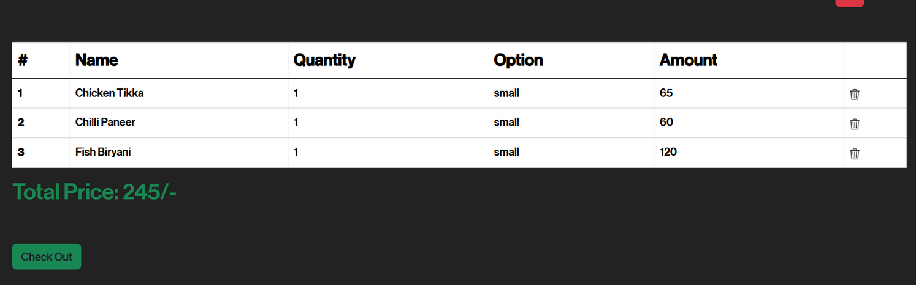
OUTPUT

Slide 11
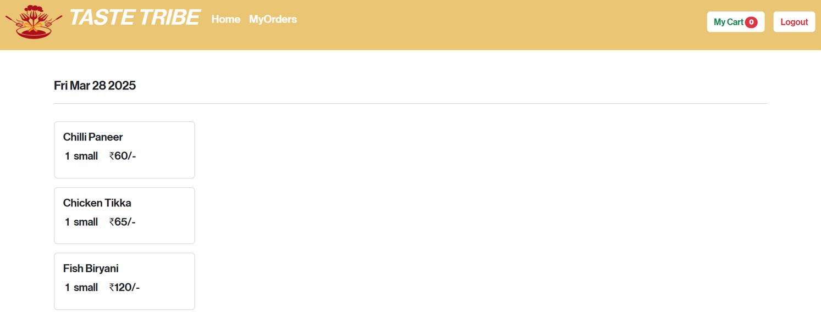
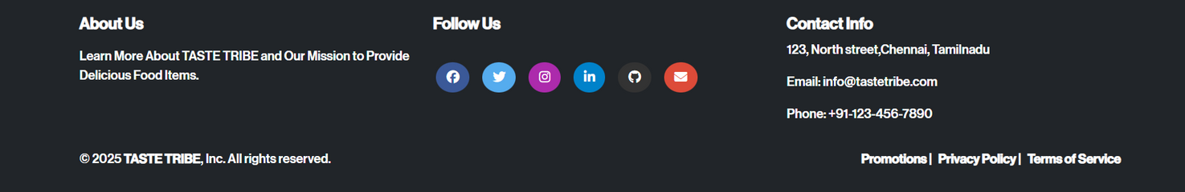
OUTPUT

Slide 12
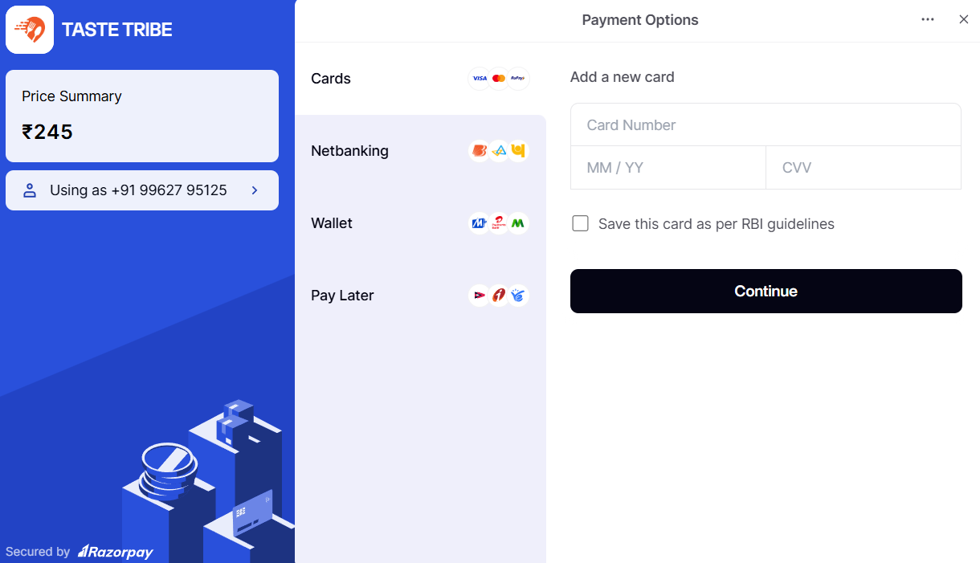
OUTPUT

Slide 13
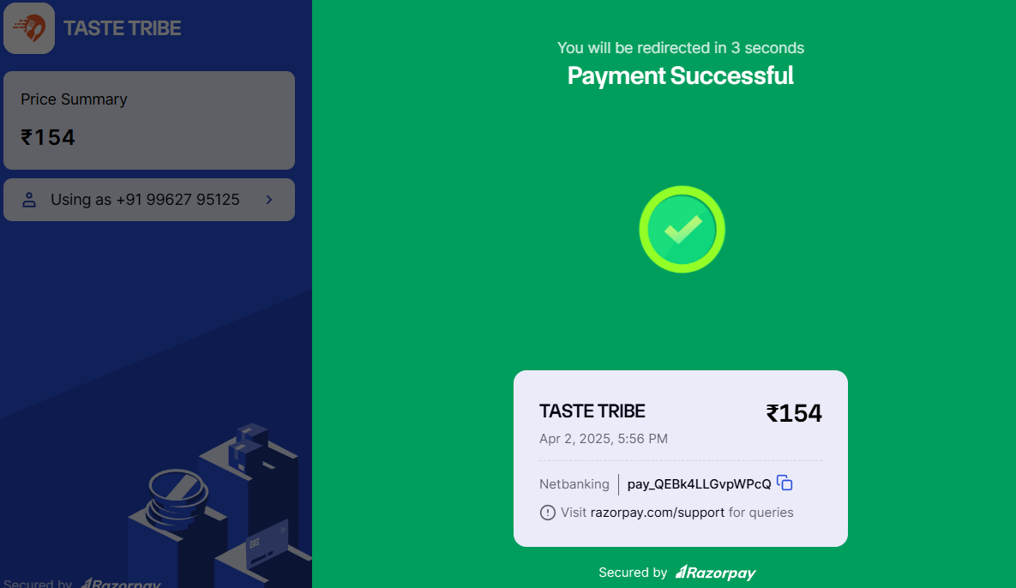
OUTPUT

Slide 14
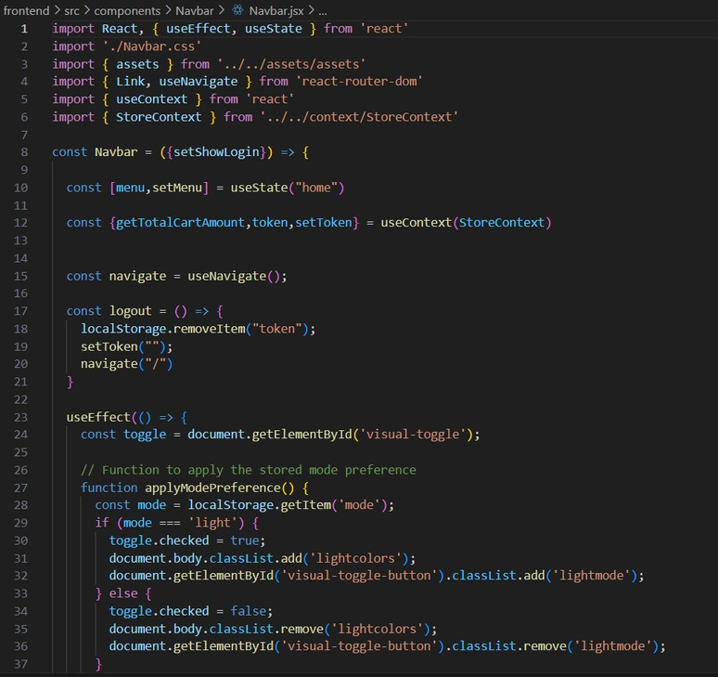
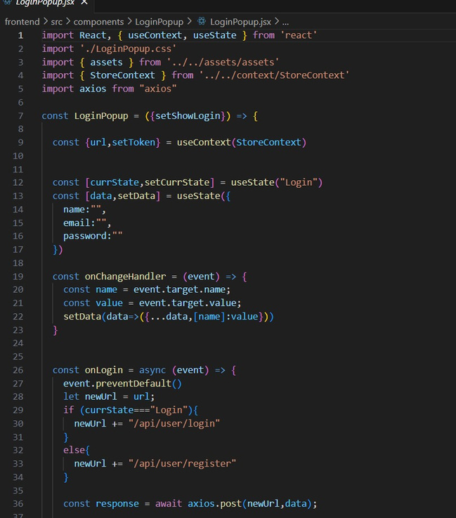
OUTPUT

Slide 15
GITHUB LINK
https://github.com/Janakiraman-23/MiniProject-final.git

Slide 16
CONCLUSION
Building a food delivery website using the MERN stack provides a seamless and efficient platform for users to browse menus, place orders, and track deliveries in real time. By integrating React for the frontend, Node.js and Express for the backend, and MongoDB for data storage, the application ensures scalability and responsiveness. With features like user authentication, cart management, and an admin panel, the system enhances both user and restaurant experiences. This project not only strengthens MERN stack skills but also demonstrates practical implementation in the food delivery industry.

Slide 17
THANK YOU

